Slide 1
Project H
Habiba Mohamed Ibrahim
Marwan Yasser
Mohamed Ahmed
Abdelrahman Mahmoud

Slide 2
Table of contents
Hypothesis testing
1
Reading the Dataset
4
Outlier detection
7
Descriptive statistics
Testing for normality/ homoscedasticity
2
5
Linear model
8
Conclusion
3
Graphics
Statistical Inference
6
9

Slide 3

Introduction
Our project is based on studies focused on the environmental and health risks of lead smelters. Our dataset inculdes childern at several locations near a lead smelter in El Paso, Texas, USA. The study involves a Control greoup of childern , and group of childern exposed to lead smelters
Variables of interests are:
MAXFWT (finger-wrist tapping score ), the number of finger taps in a period of 10 second. It is considered a proxy for the integrity of the neuromuscular system. The higher the score the better. It can be measured for the left and the right hand. We will use the maximum of the two as outcome variable.
Iqf(full-scale IQ score), higher score is better.
In addition to other variables should be account like Age, and Sex,
the research questions was how the MAXWT is related to the lead concentrations in the blood μg/100 ml (Ld72 and Ld73 for measurements in 1972 and 1973 ) and to the total number of years the child lived in the proxy of the lead smelter (Totyrs).

Slide 4
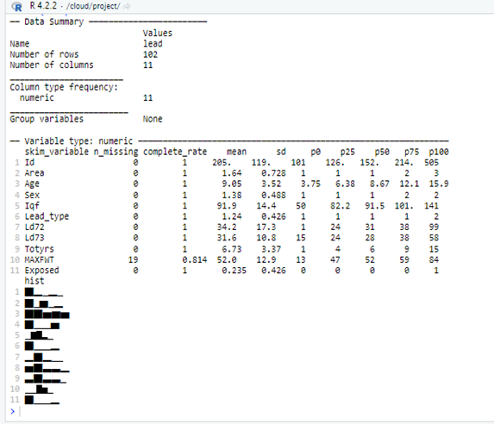
Reading the Dataset
We read the data and analyze it to know the variables we going to work on.
Our data contains 11 columns (Variables). Id , Area ,Age, Sex, Iqf, Lead type, Ld72, Ld73, Totyrs, Maxfwt, and Exposed.
By using skimr command, we get the statistical summary about variables in data frames, tibbles, data tables and vectors.

Slide 5
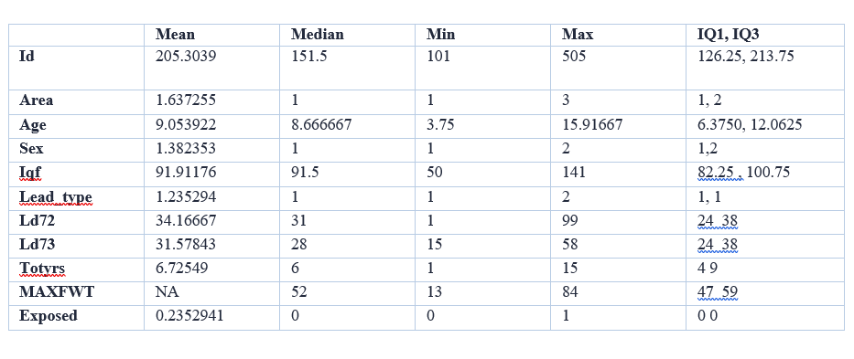
Descriptive statistics
We read the data and analyze it to know the variables we going to work on.
Our data contains 11 columns (Variables). Id , Area ,Age, Sex, Iqf, Lead type, Ld72, Ld73, Totyrs, Maxfwt, and Exposed.
By using skimr command, we get the statistical summary about variables in data frames, tibbles, data tables and vectors.
We need to be able to describe samples by summary statistics (mean,median, variance, etc) so that these summaries can serve as an estimate of the same summaries for their statistical populations.
Univariate analysis is the simplest form of analyzing data Consider only one variable (hence “Uni”) It does not deal with relationship between variables.

Slide 6
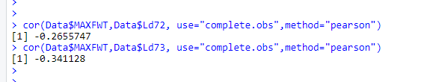
The correlation coefficient (MAXFWT and Ld72) and (MAXFWT and Ld72), we used Pearson method. (the most common way of measuring a linear correlation. It is a number between –1 and 1 that measures the strength and direction of the relationship between two variables. When one variable changes, the other variable changes in the same direction).
MAXWT and Ld72 =-0.2655747
MAXWT and Ld73 = -0.341128
For the categorical variable existing, calculate a frequency table; there is one categorical variable which is Sex that contain 63 male and 39 female.

Slide 7
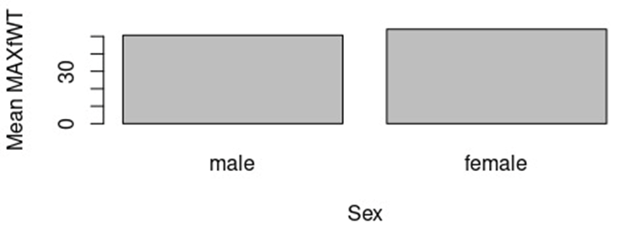
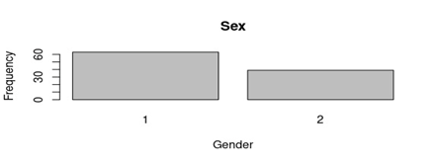
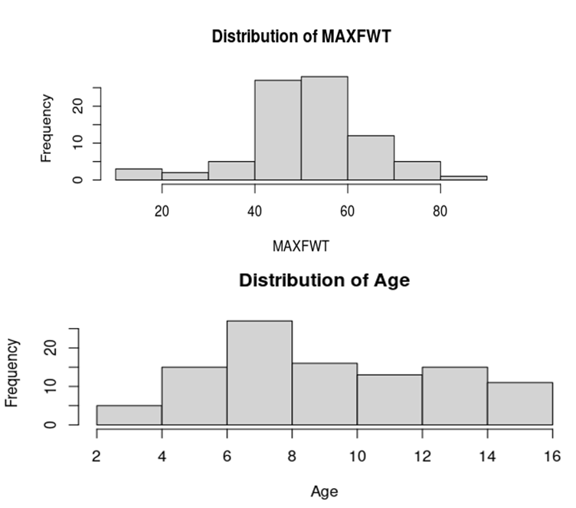
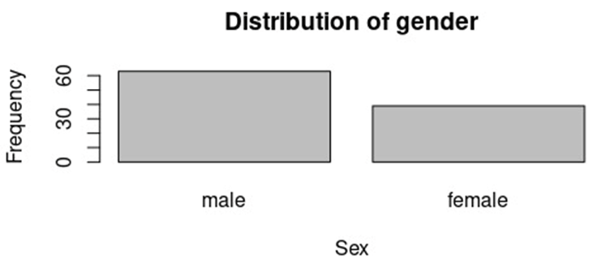
Graphics
a bar chart graph with mean of MAXFWT in males and females
a bar chart of a categorical variable for the gender variables
a histogram of a continuous variable: “age” as well as “ MAXFWT

Slide 8
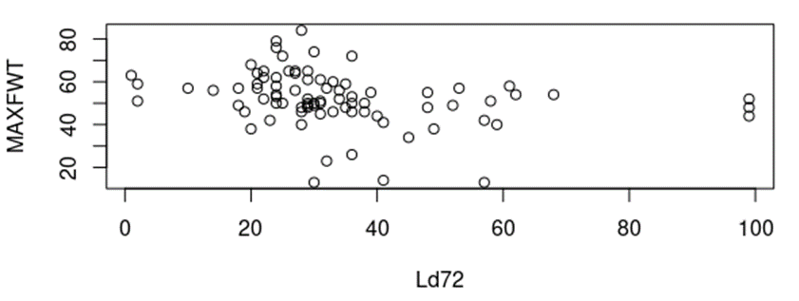
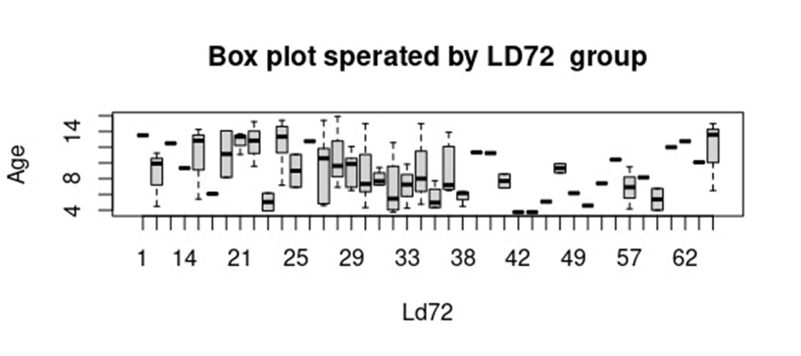
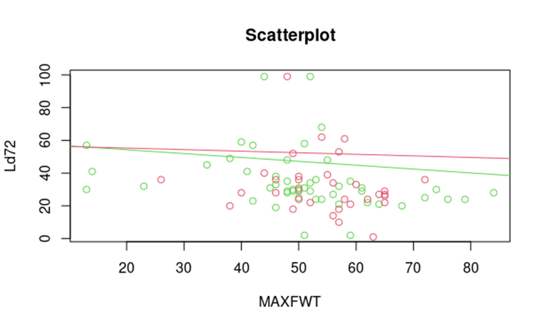
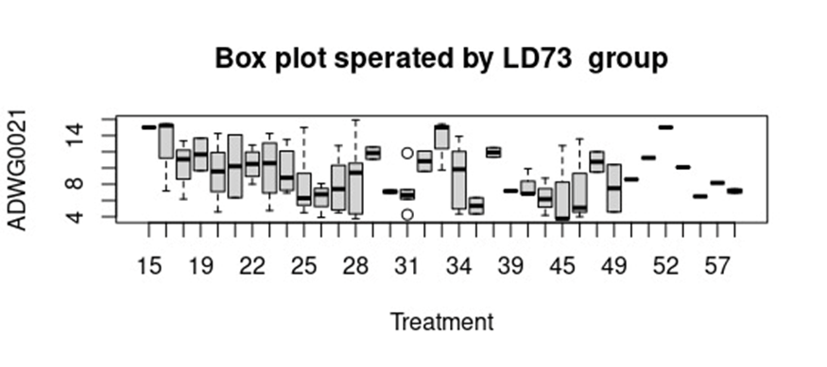
a scatterplot of 2 continuous variables Ld72 and MAXFWT, and add the regression lines for each gender
Make a boxplot of age and a separate boxplots per Ld72 and per Ld73 (as.factors).

Slide 9
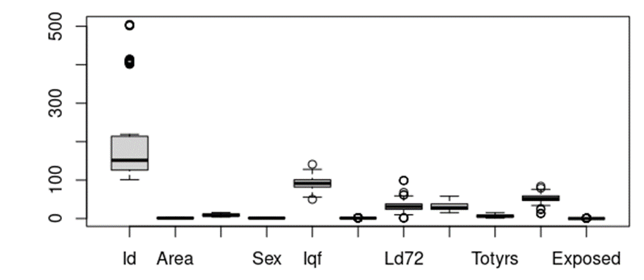
Outlier detection
Outlier is an extremely high or extremely low data point relative to the nearest data point and the rest of the neighbouring co-existing values in a data graph or dataset you're working with. Outliers are extreme values that stand out greatly from the overall pattern of values in a dataset or graph. Outliers may have a negative effect on the result of an analysis, therefore they must remove them

Slide 10
How to test?
Normality
01
02
Graphs
Normality Tests
QQ plots
Histogram
shapiro-wilk

Slide 11
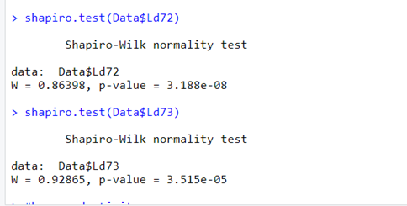
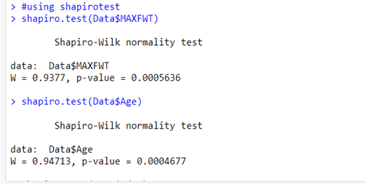
Normality
Null hypothesis (P>0.05)
The values are sampled from a population that follows a normal distribution.
Alternative hypothesis (P <= 0.05)
The values are not sampled from a population that follows a normal distribution.

Slide 12
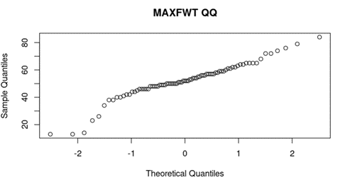
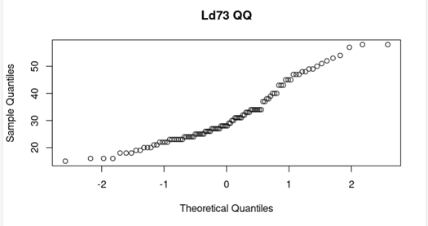
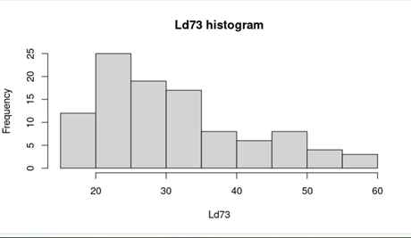
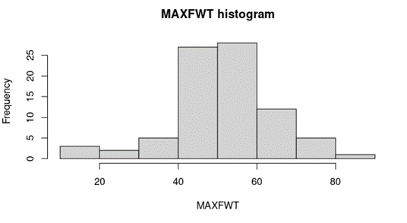
Normality

Slide 13
How to test?
Homoscedasticity
01
02
Graphs
Tests
residuals plot
bartlett test

Slide 14
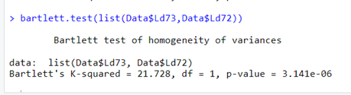
Homoscedasticity
From the output, can be seen that the p-value of 3.141e-06 is less than the significance level of 0.05. This means the null hypothesis can be rejected that the variance is not the same for all treatment groups.

Slide 15
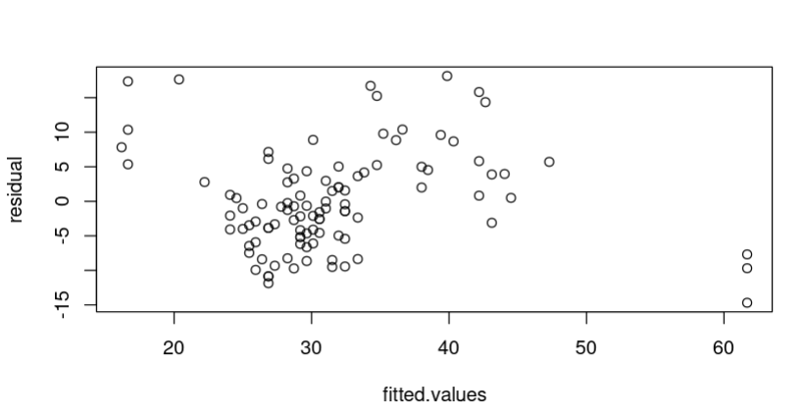
Homoscedasticity
This residual plot implies that the distribution of variances across x values are not homogeneous.
Between Ld73 and Ld72

Slide 16
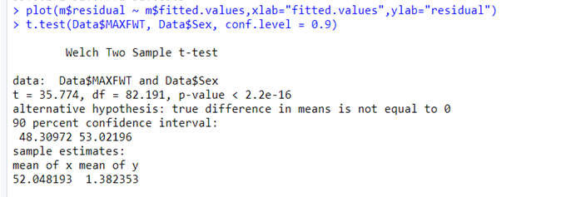
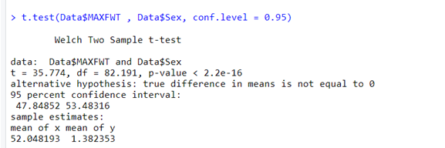
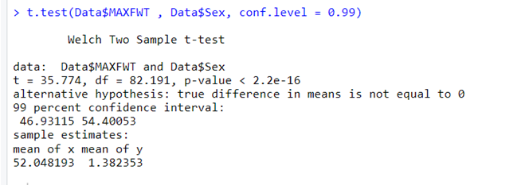
Statistical inference
90% confidence level
95% confidence level
99% confidence level
Those inferences are inconsistent because the confidence intervals changes with different confidence levels.
We can also observe that when the interval width gets wider the confidence level increases.

Slide 17
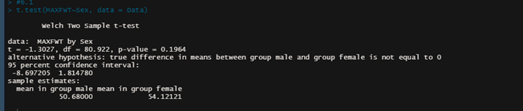
Hypothesis testing
MAXWT (finger-taps) difference between males and females.
No significance.

Slide 18
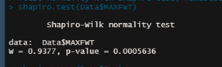
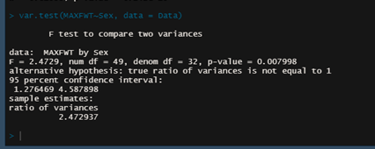
Hypothesis testing
2. MAXWT (finger-taps) difference between males and females. (assess the assumption)
Assumption are true for for normality and homoscedasticity.

Slide 19
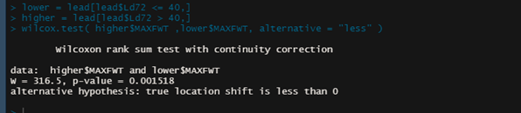
Hypothesis testing
3. MAXWT (finger-taps) is correlated with Ld72 concentration above and below 40.
There is significance between the two groups..

Slide 20
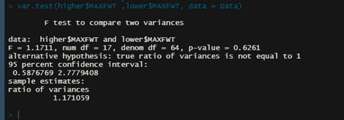
Hypothesis testing
4. MAXWT (finger-taps) is correlated with Ld72 concentration above and below 40.(assess heterosdacitsity)
No significance data is heteroscedastic.

Slide 21
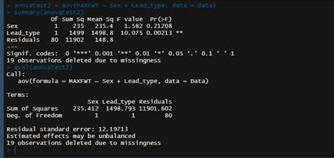
Hypothesis testing
5. MAXWT is different between the different Lead types with the different genders.
There is correlation between males only in the two types and females only in the two types.

Slide 22
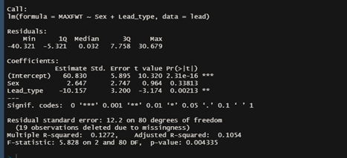
Linear Model
1 .fit a linear regression model to the data so we chose the previous assumbtion

Slide 23
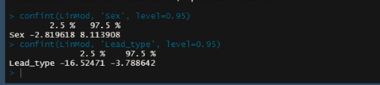
Linear Model
2. 95% confidence interval of the regression

Slide 24
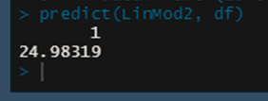
Linear Model
3. Estimating the average MAXWT reduction for with increasing the lead concentration (Lead73) to 100 μg /100 ml

Slide 25
Any Questions?
Thank you

